Slide 2
Objectives
Describe how web pages are located, retrieved and displayed when a user enters a URL, including the role of:
The web browser
IP addresses
The domain name system server (DNS server) and web server
HTML
Explain what is meant by cookies including:
Session cookies
Persistent cookies

Slide 3
Starter
When a URL (web address) is requested by the user, the browser knows the domain name, as it is in the URL
But the Internet makes use of IP addresses
How does a browser know which IP address to send a web page request to if it only knows the domain name?

Slide 4
Starter
How does a browser know which IP address to send a web page request to if it only knows the domain name?
It makes use of a domain name system server (DNS server)
The DNS server will translate the domain name into a corresponding IP address

Slide 5
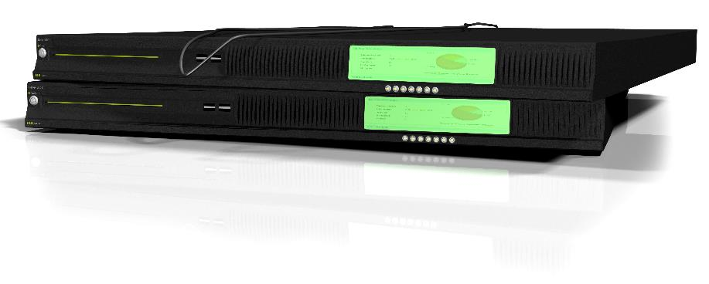

Web servers
Websites and web pages are stored on web servers
These are dedicated machines that are used to serve web pages to devices that request them
An ordinary computer can be turned into a web server by installing web server software
Commercial web servers are a physical size that allows many of them to be placed inside a server cabinet
Data centres will be filled with server cabinets

Slide 6

The Domain Name System
The Domain Name System is a global system that maps domain names to IP addresses
Browsers ask DNS servers to translate a domain name to an IP address so that they know where to send requests
The DNS system is similar to a telephone directory
wikipedia.com
198.35.26.98
wikipedia.co.uk
208.80.154.232

Slide 7
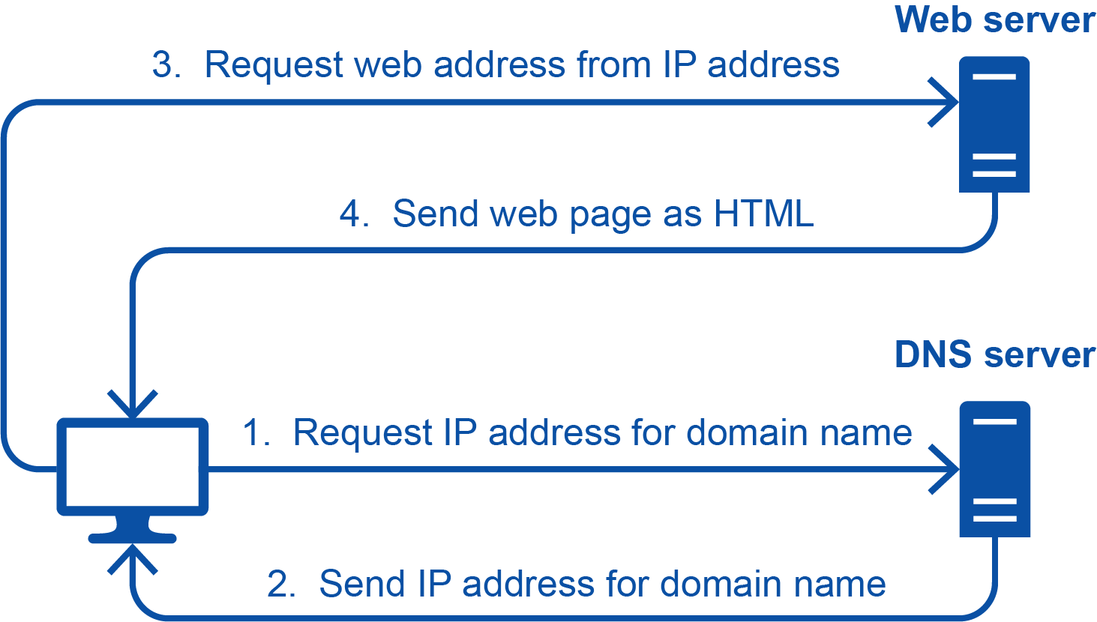
How web requests work
When the user requests a web page the following happens:
The web browser requests the IP address of the domain name from the DNS server
The server sends the IP address to the web browser
The web browser sends a request for the web page to the IP address
The web server sends the web page, in HTML, to the browser

Slide 8
Worksheet 4
Complete Task 1 on Worksheet 4

Slide 9
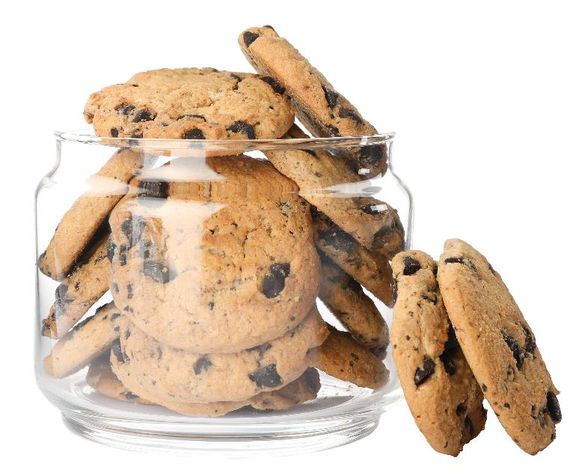
Cookies
Cookies are small amounts of data sent to a web browser
You can think of them as extra text files sent with the web page
The cookie data is stored in a browser file so that it is able to be accessed at a later time
What is the purpose of a web server sending cookies to a user’s web browser?

Slide 10
Cookies
Cookies are used in many ways including:
Saving personal details
Tracking user preferences
Holding items in an online shopping cart
Storing login details

Slide 11
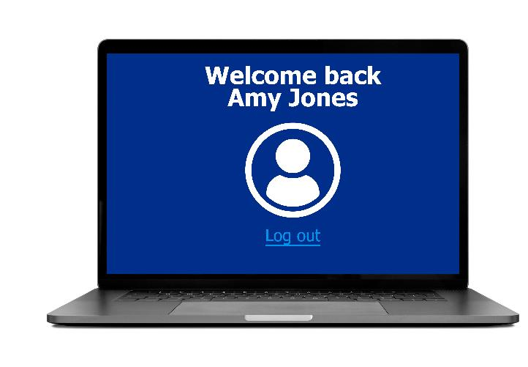
Persistent cookies
Persistent cookies remain on the computer even if the web browser is closed or the computer is turned off
This allows a user to remain logged into a website or items in a shopping cart not to be lost
The programmer of the website will specify the expiry date for the persistent cookie – after that date the cookie is deleted by the browser

Slide 12

Session cookies
Session cookies only last for the browsing session
They don’t have an expiry date which indicates that they are a session cookie
They are stored temporarily in memory and not on secondary storage
When the browser window is closed or the computer is turned off, the session cookies will be lost

Slide 13
Worksheet 4
Complete Task 2 on Worksheet 4

Slide 14
Plenary
Fill in the blanks by using the words beneath the text
When a user enters a _______________, the domain name is sent to a _______________. The DNS server looks up the _______________ and sends the associated _______________ to the web browser. The web browser now requests the web page to the IP address for the _______________. The web server then sends the web page, written in _______________, to the browser.
Domain name IP address HTML Web server URL DNS server
Explain the difference between session cookies and persistent cookies

Slide 15
Plenary
Fill in the blanks by using the words beneath the text
When a user enters a URL, the domain name is sent to a DNS server. The DNS server looks up the domain name and sends the associated IP address to the web browser. The web browser now requests the web page to the IP address for the web server. The web server then sends the web page, written in HTML, to the browser.
Explain the difference between session cookies and persistent cookies
Session cookies are deleted after the browser window closes
Persistent cookies remain on the computer until their expiry date

